Slide 1
2048
Peshkov Alexey, Maksunova Ekaterina, TImofeev Marat

Slide 2
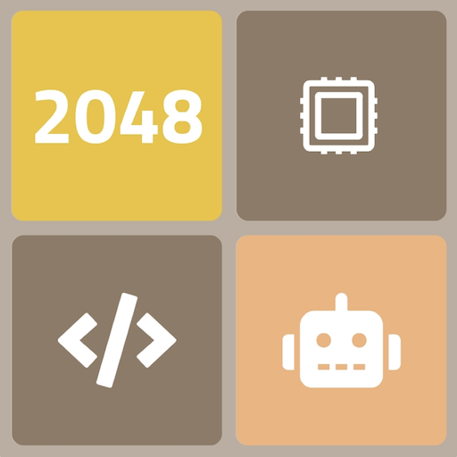
Project Goals
Create a 2048 game.
Create an AI to play it.

Slide 3
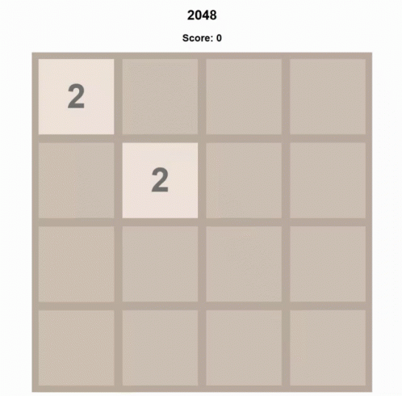
Game mechanics summary
4x4 playing field
Movement logic: combine equal tiles, spawn new ones
Win condition: tile with value 2048
Loss condition: no possible moves

Slide 4
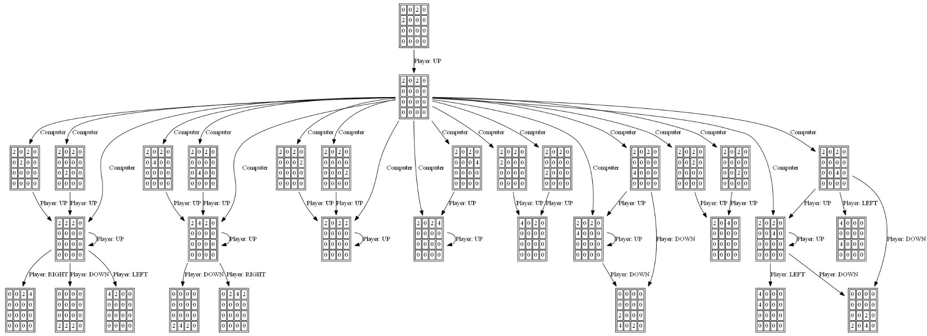
Unique Twist - Not Just a Game
We implemented two game modes: Ai and human. You can switch between them during the game!

Slide 5
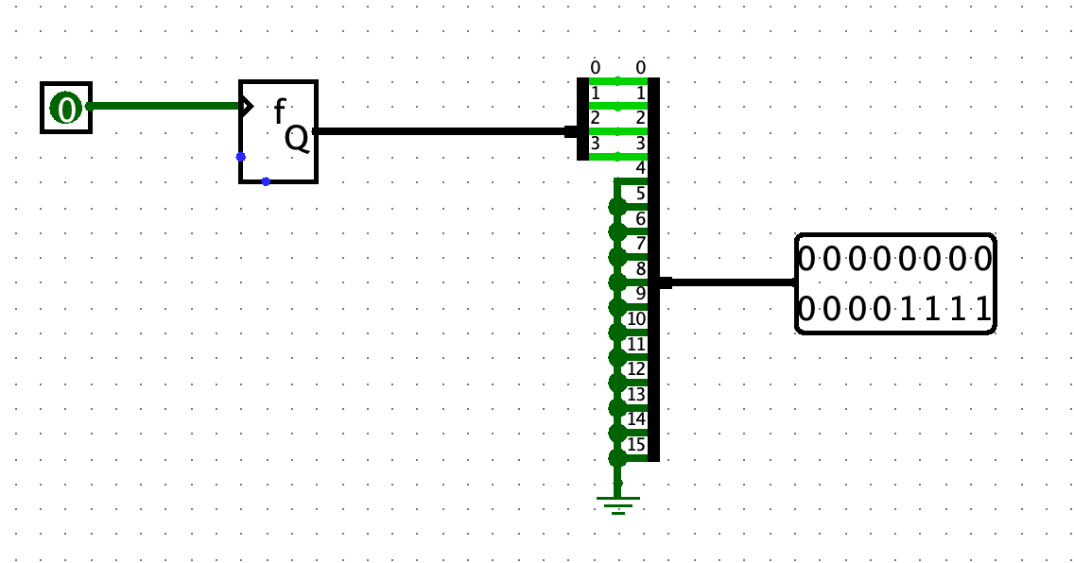
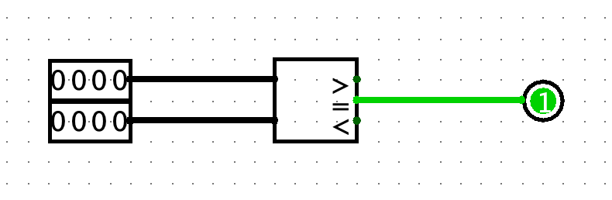
Hardware architecture
Helpers

Slide 6
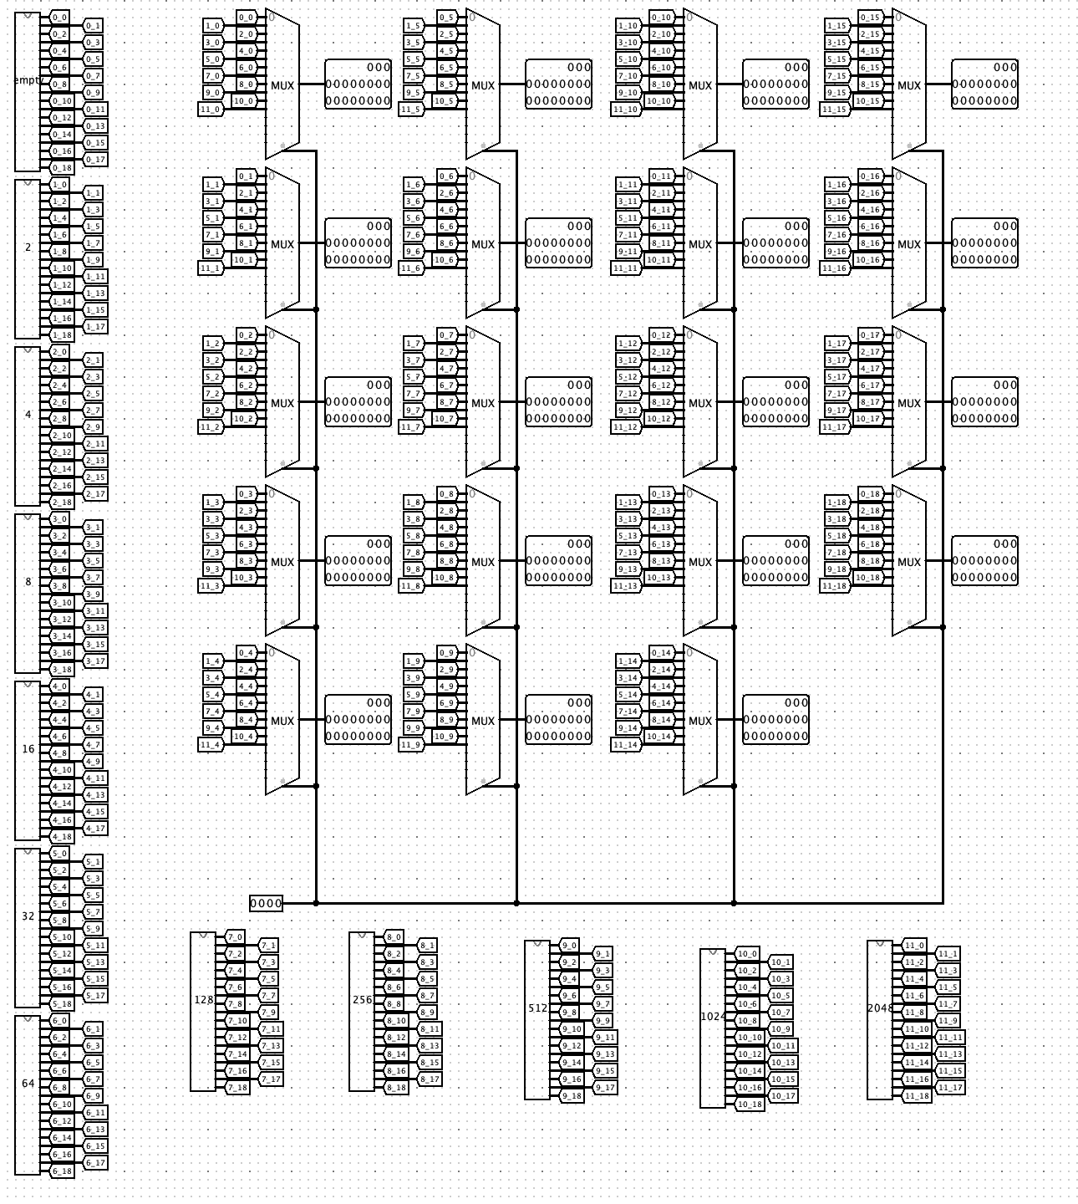
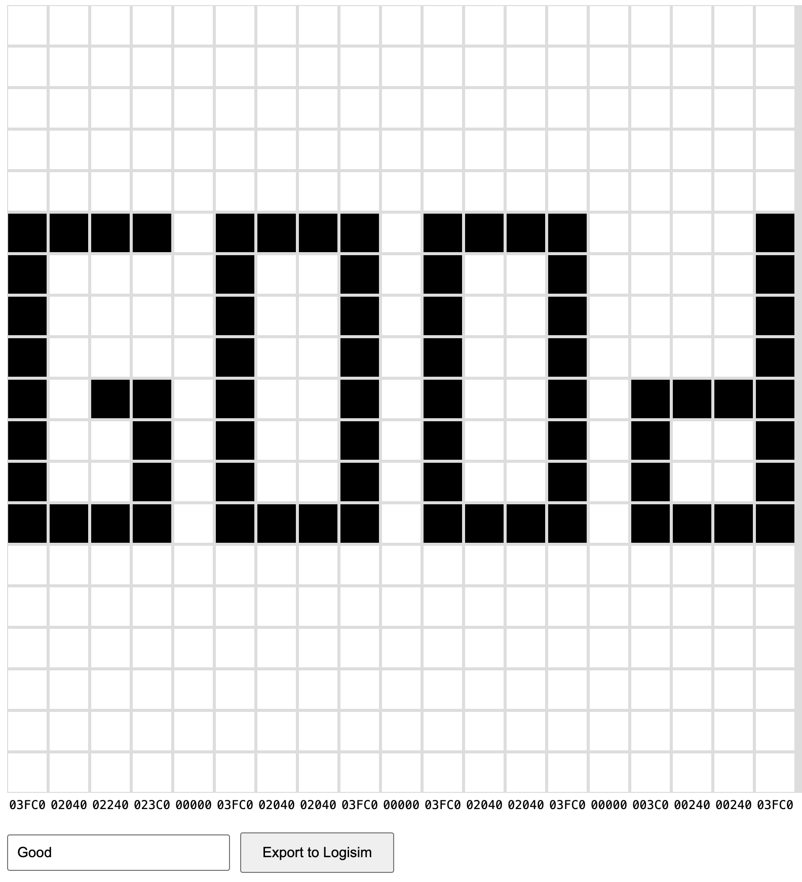
Hardware architecture
Number picker

Slide 7
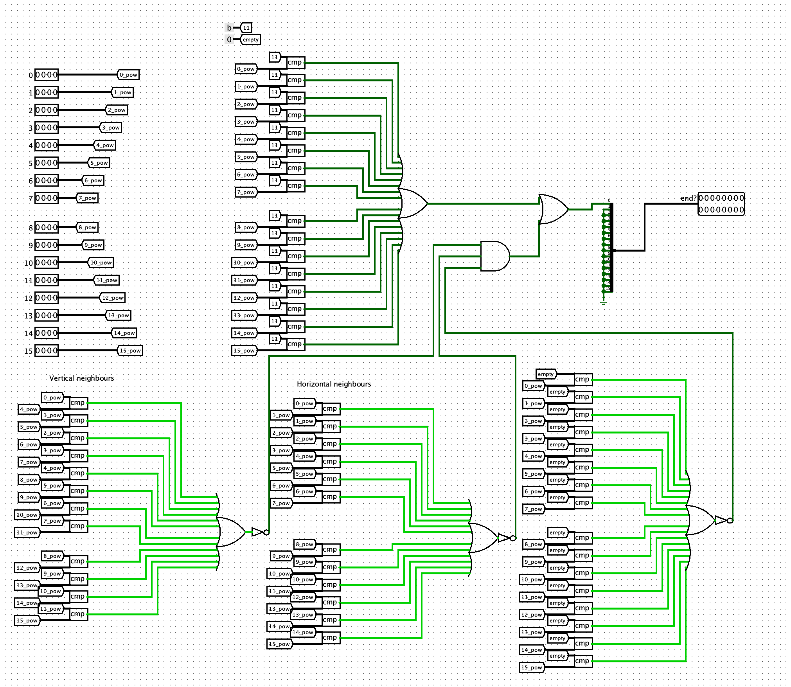
Hardware architecture
Game over check

Slide 8
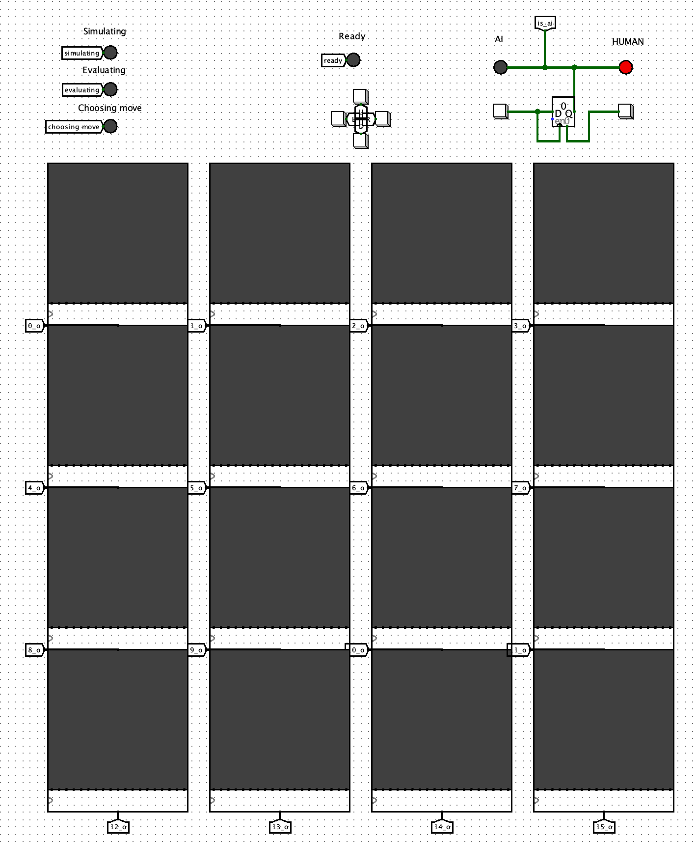
Hardware architecture
Game field
Buttons
Game mode selector
Status of the game

Slide 9
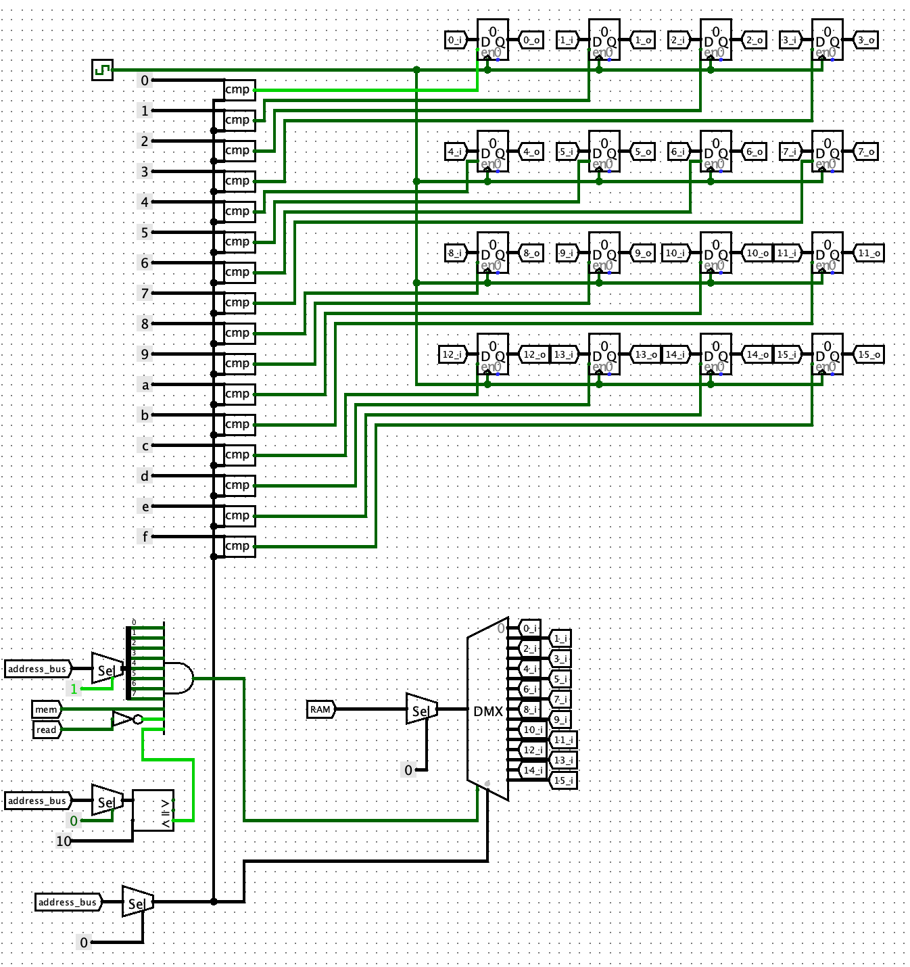
Hardware architecture
Registers for matrix

Slide 10
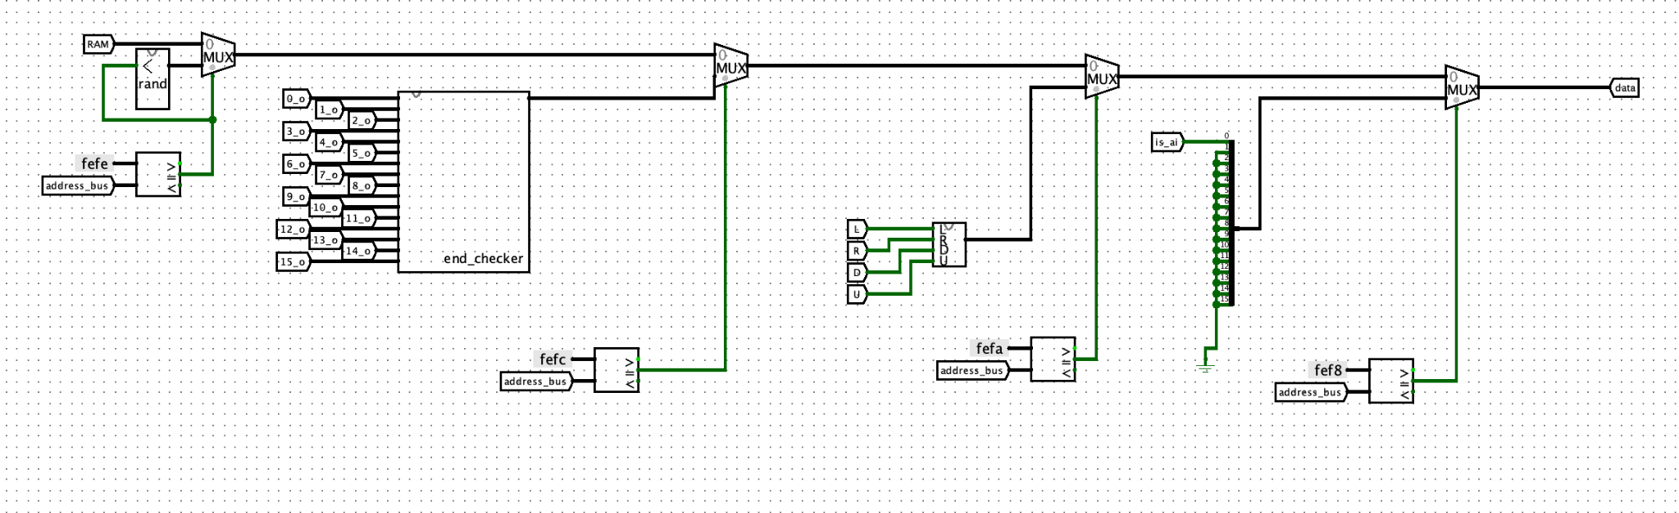
Hardware architecture
Link components to processor

Slide 11
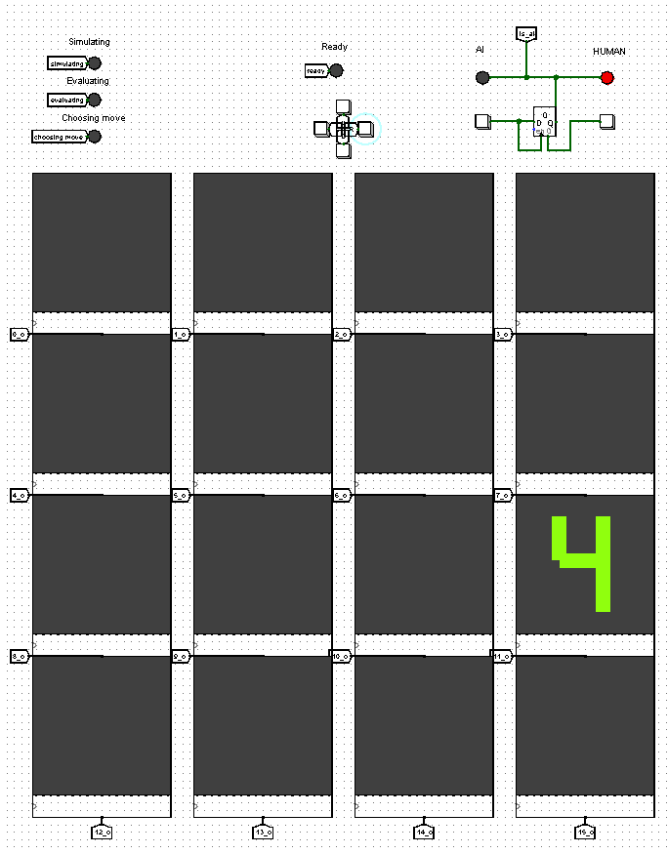
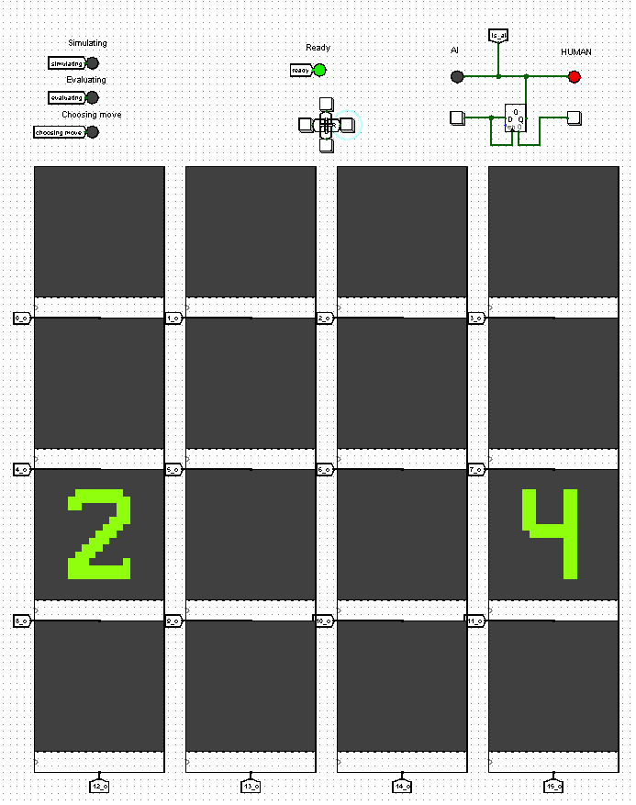
Software
Place tiles
place a random tile on a random empty space

Slide 12
Software
Board evaluation
is biggest tiles in corner?
amount of empty tiles
amount of possible merges
smoothness
monotonicity

Slide 13
Software
Move tiles
No code optimizations like transpose/mirror to maximize performance.
If move is invalid (no tiles were moved), the new tile will not be placed.

Slide 14
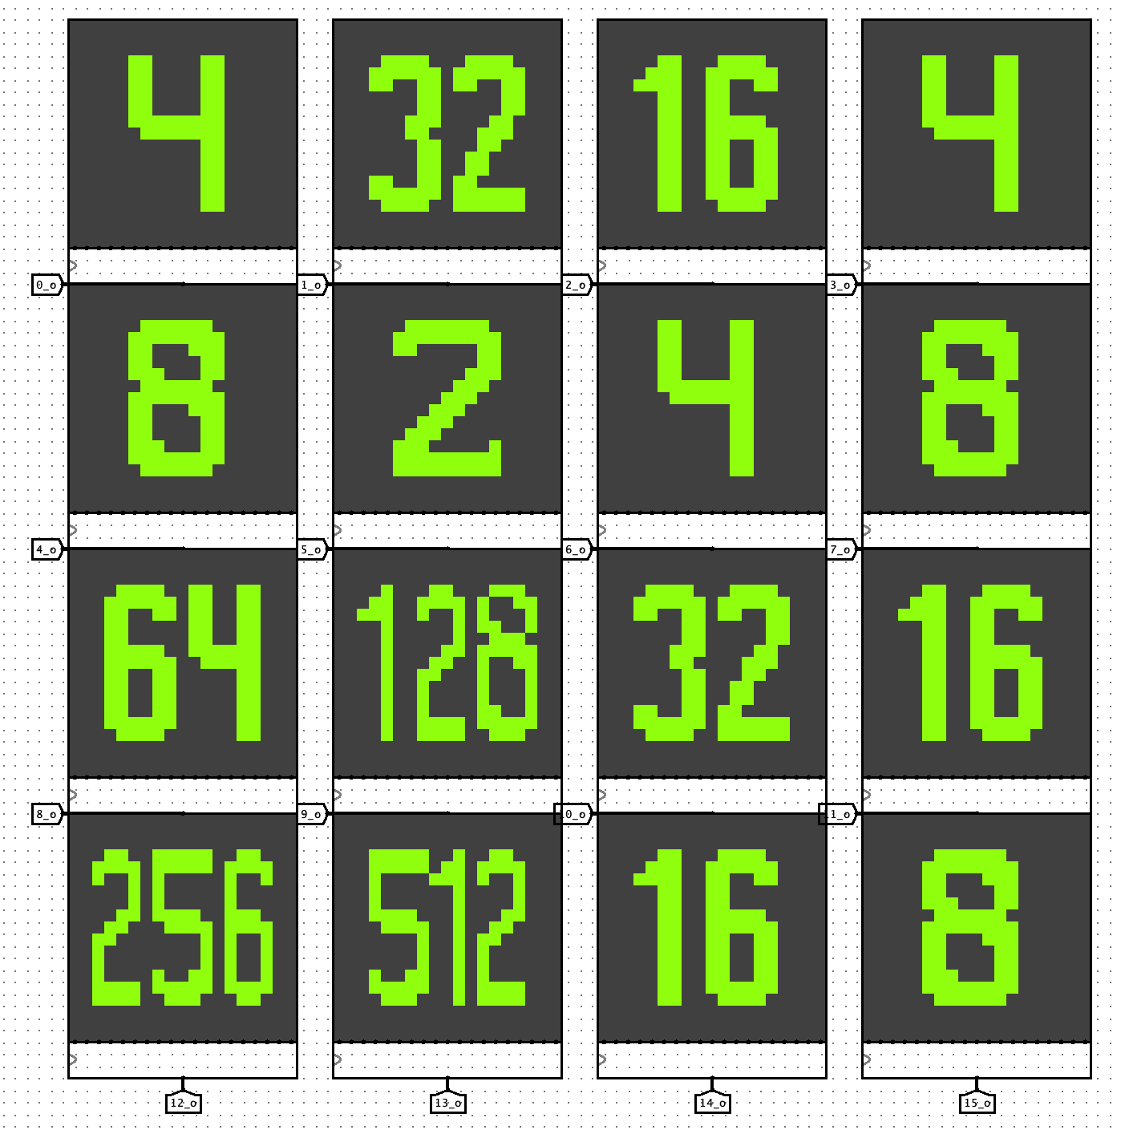
Software
Main game cycle
check if game is already over
check current game mode (AI or human)
make a move!
repeat

